Slide 1
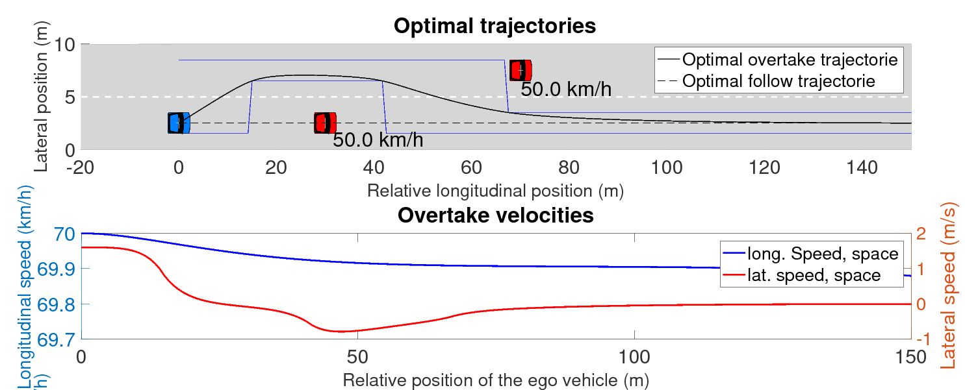
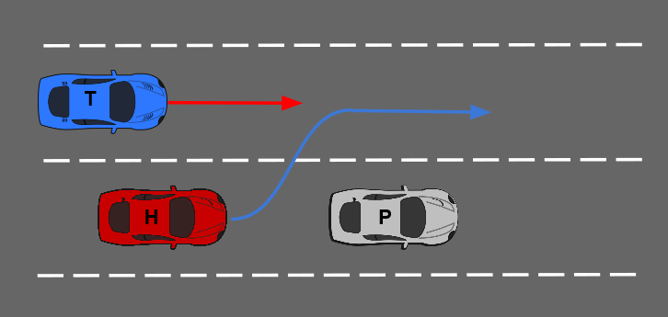
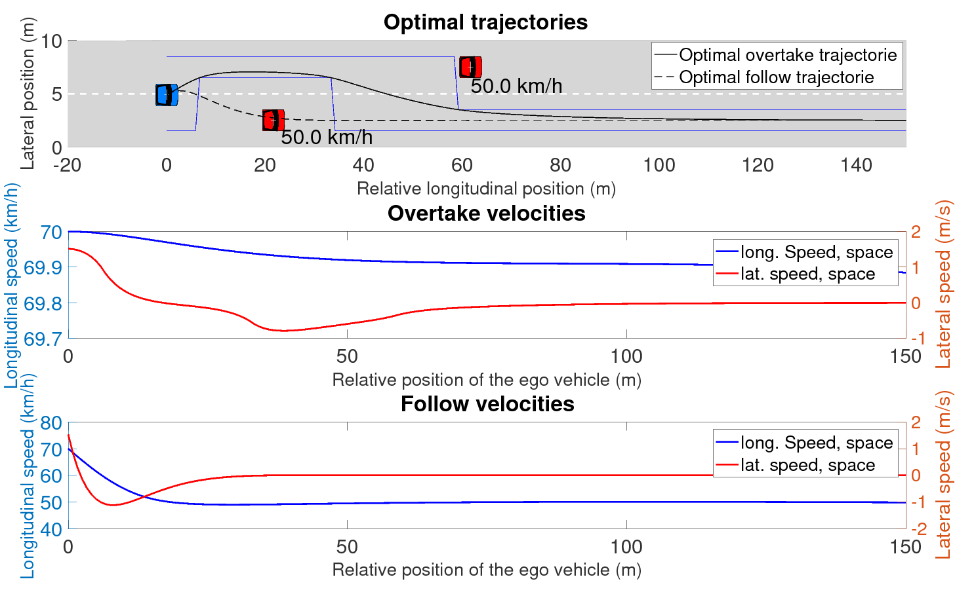
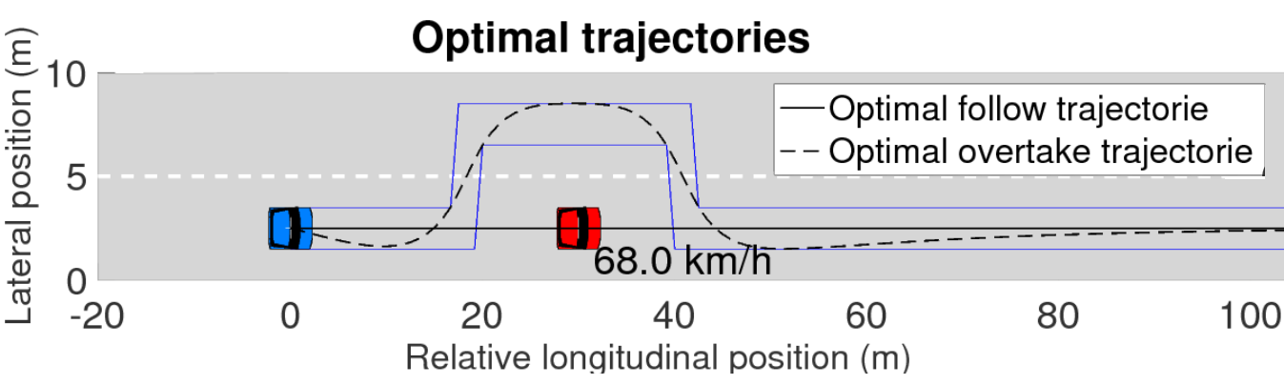
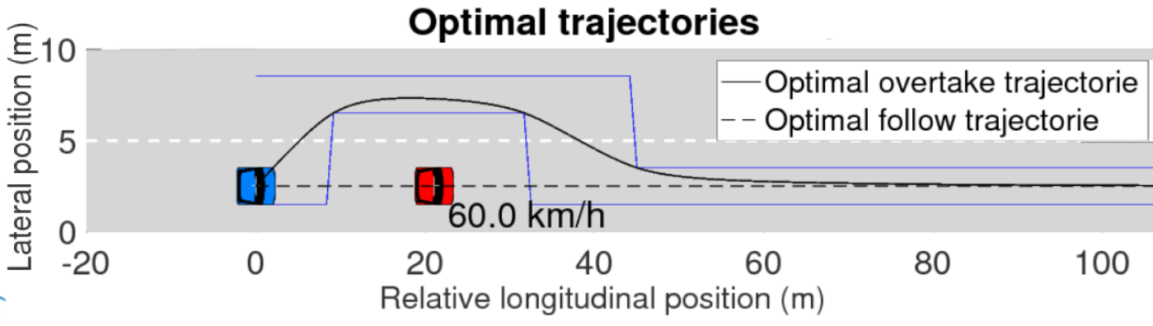
Optimal Overtaking for Autonomous Vehicles
Purpose
Cars often find themselves behind slower moving vehicles such as trucks on the highway. In these situations, they must make the decision to either overtake or trail the leading vehicle, weighing both decisions to make a safe, yet optimal manoeuvre.
II. Scenario 2 – Adjacent vehicle with deceleration
The host follows a slower moving pilot at 50kph while another vehicle drives a distance away on the adjacent lane at 50kph. Initially, an overtake is deemed necessary and the host begins the lane change.
Method
An optimal path for the overtaking manoeuvre is developed in previous work.
On similar lines, an MPC problem over a fixed space horizon is solved to yield an optimal trailing manoeuvre.
At each instant, the overtaking and following manoeuvres are evaluated against each other
This is done using an objective function that compares the kinematics of the manoeuvres, the deviation from the reference speed and the decision robustness
In the middle of the lane change, the vehicle in the adjacent lane slows down to 40kph requiring the host to abort the manoeuvre.
Evaluation
Scenario 1 - Leading vehicle with deceleration -
The host follows a vehicle that slows down making an overtake necessary. The reference speed is 70kph. Initially, when the pilot drives at 68kph,the overtake is more expensive.
III. Scenario 3
Later, when the leading vehicle has slowed down to 60kph, following becomes more expensive and the decision to overtake is made.
Notes:
<number>

